Slide 1

Spirit of Giving Back & Social Entrepreneurship- CSL Presentation

Slide 2

Disclaimer!!
Self Branding & Grammarical Errors

Slide 3
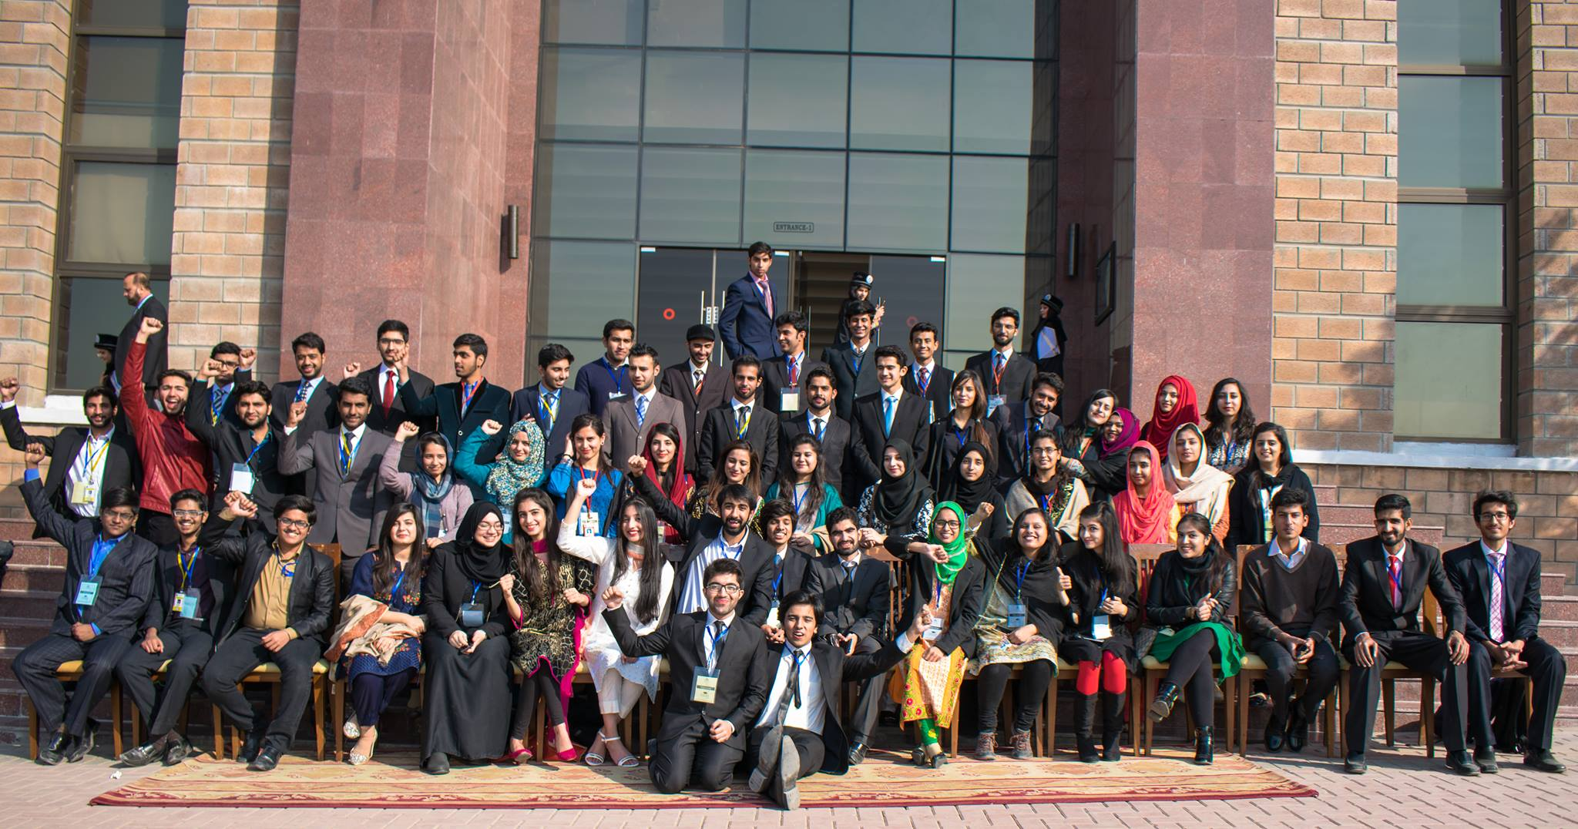
Convocation 2016- General Secretary SGA

Slide 4
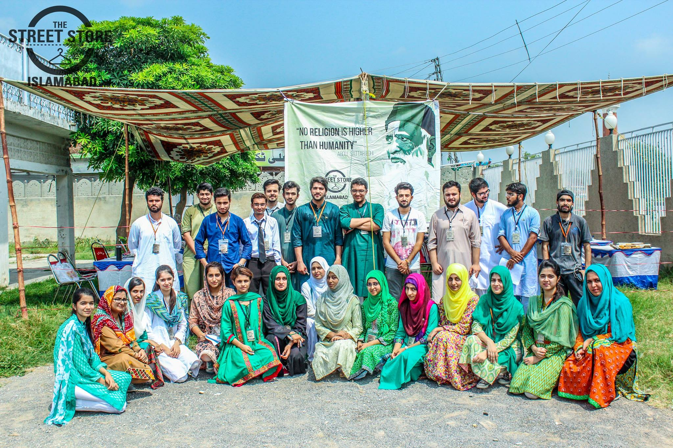
President Chadar- 2017-2018

Slide 5
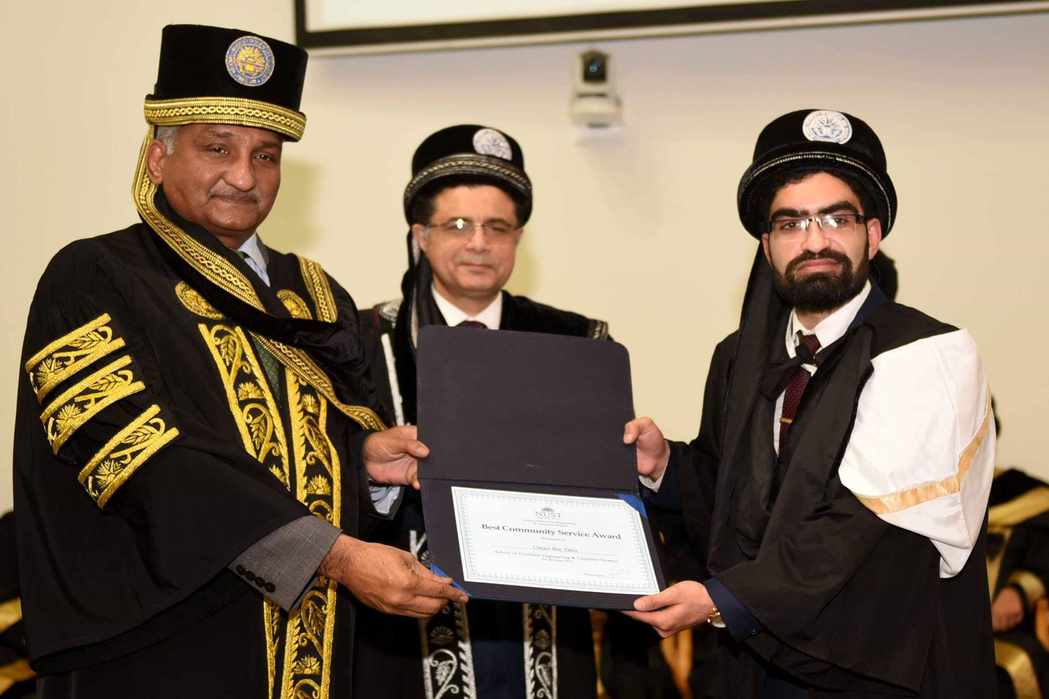
Convocation 2018

Slide 6
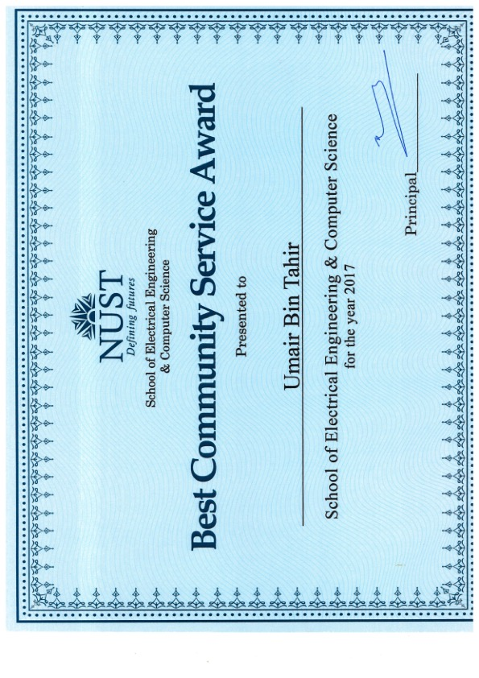
Community Service Award

Slide 7
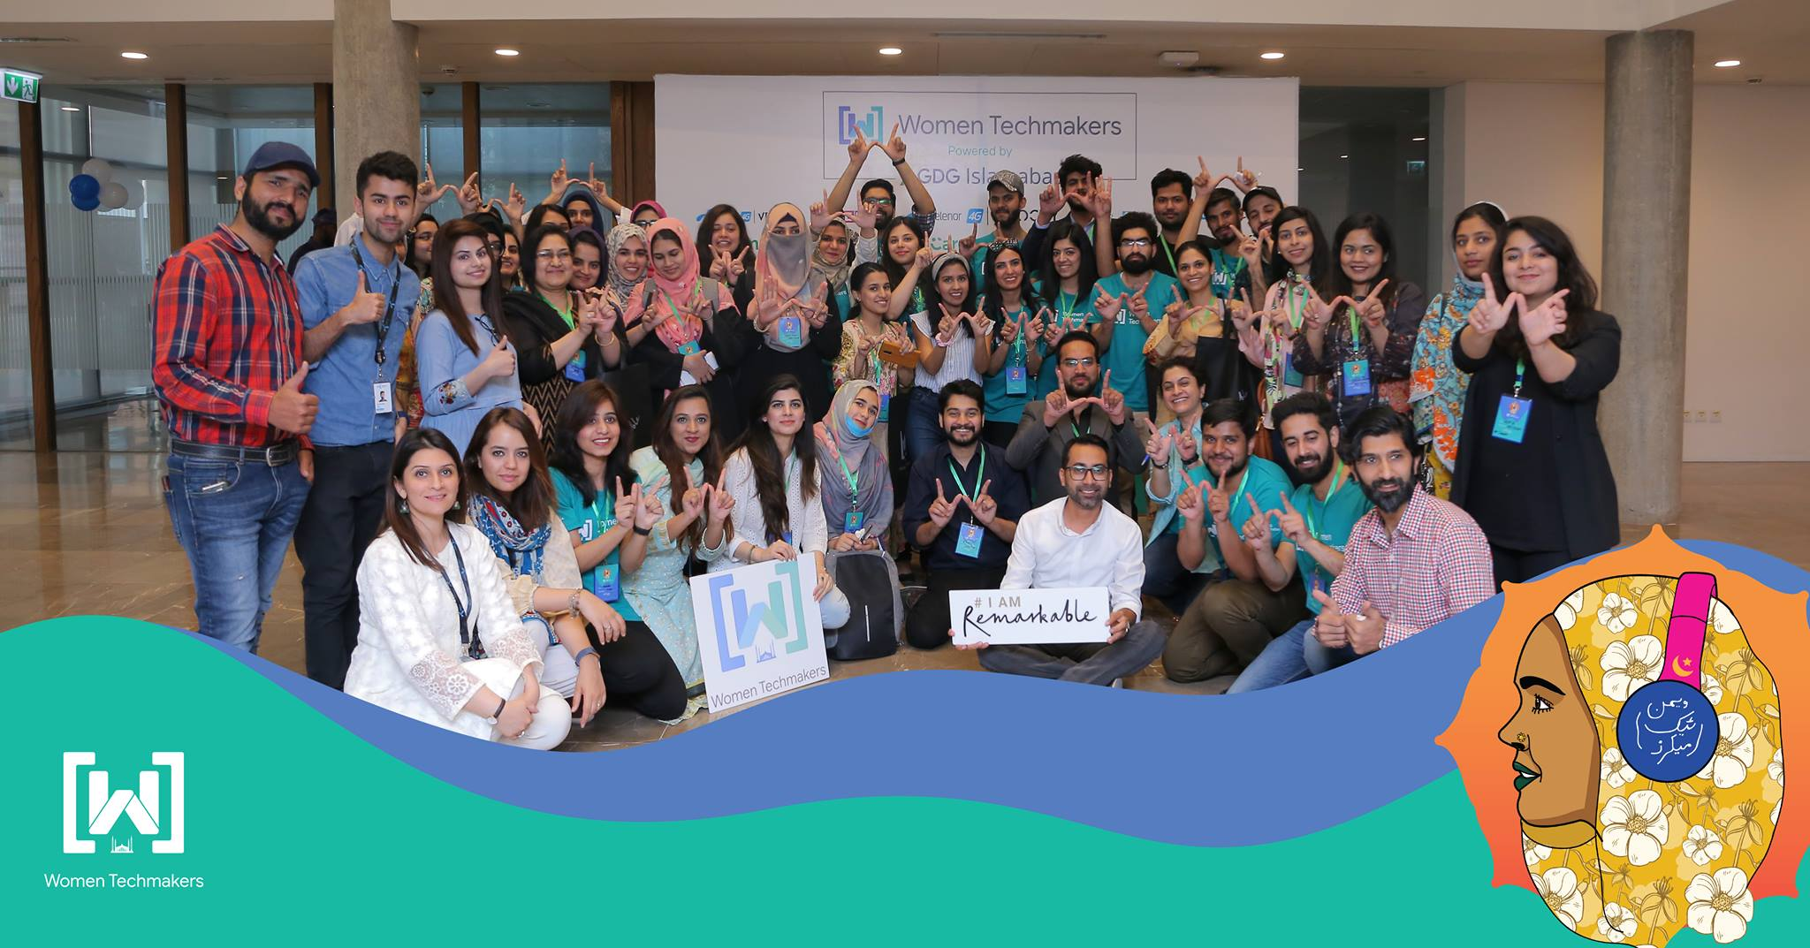
Google Developers Group Islamabad

Slide 8
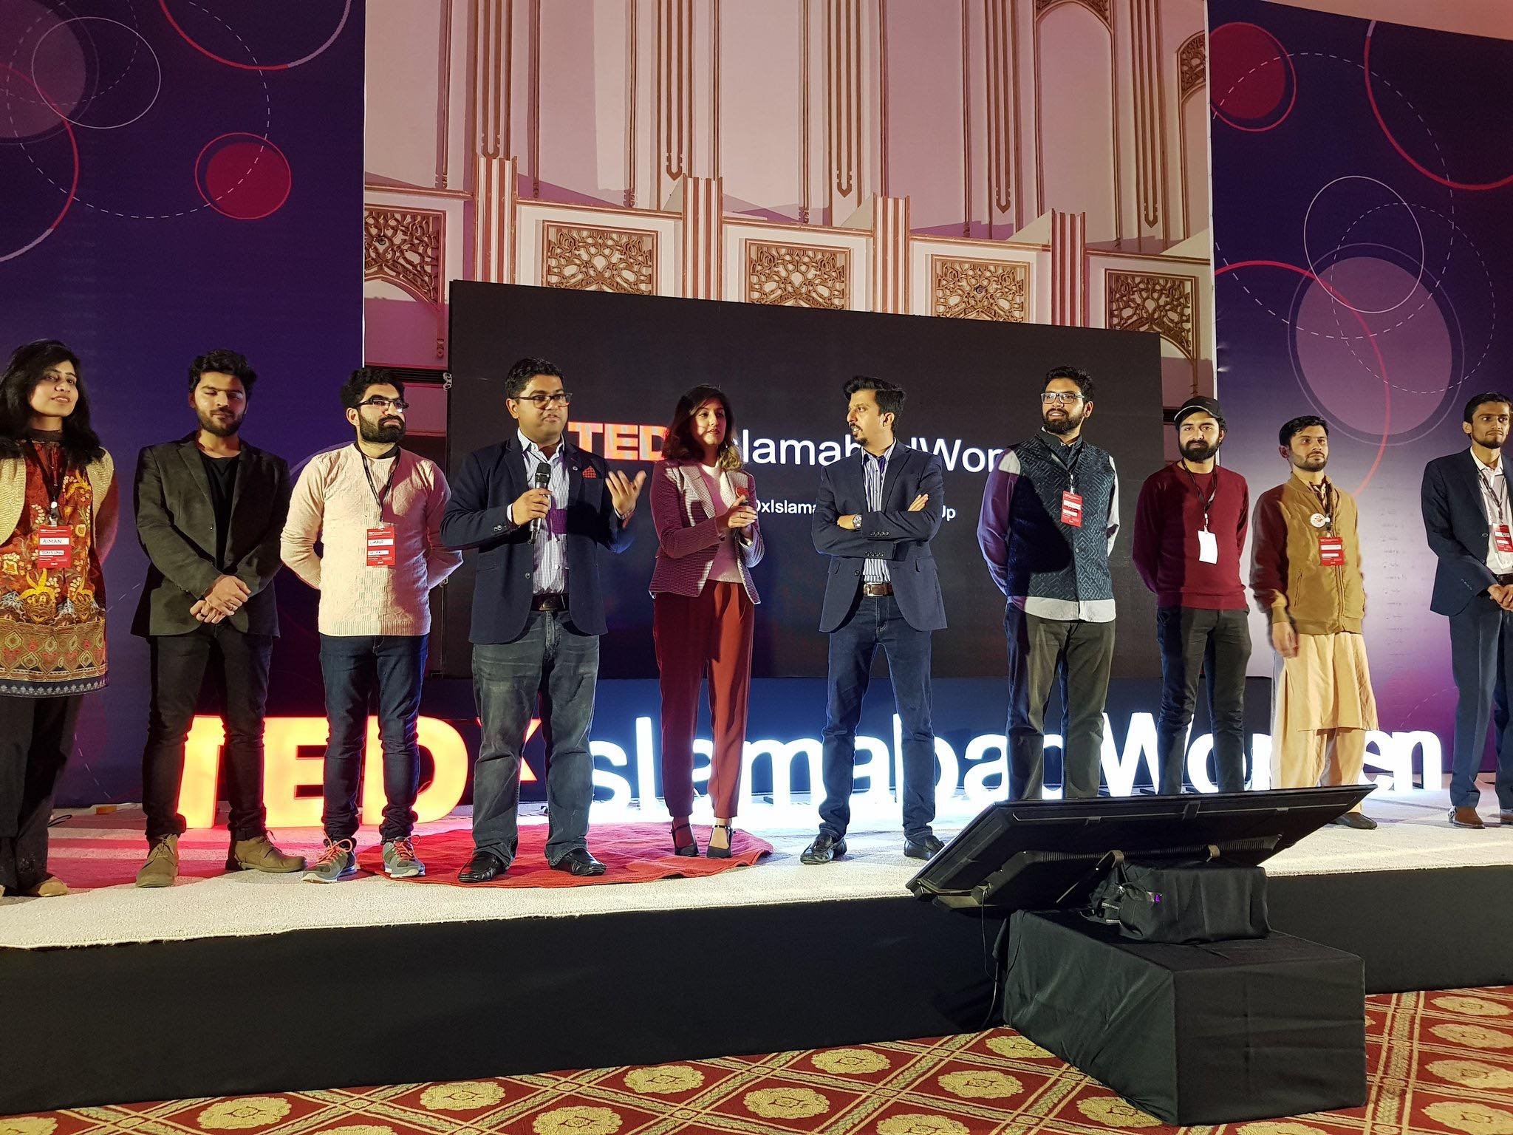
TEDX Islamabad

Slide 9

Global Shaper at World Economic Forum

Slide 10
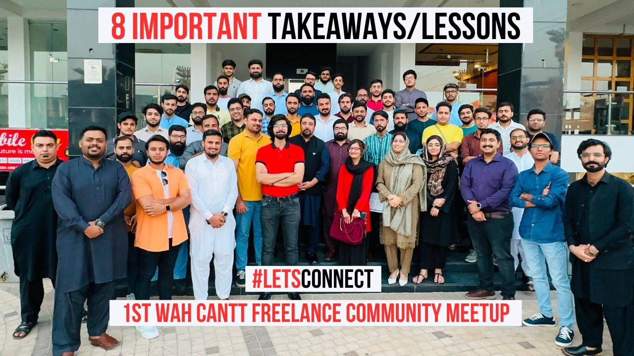
Freelancers Meetup

Slide 11
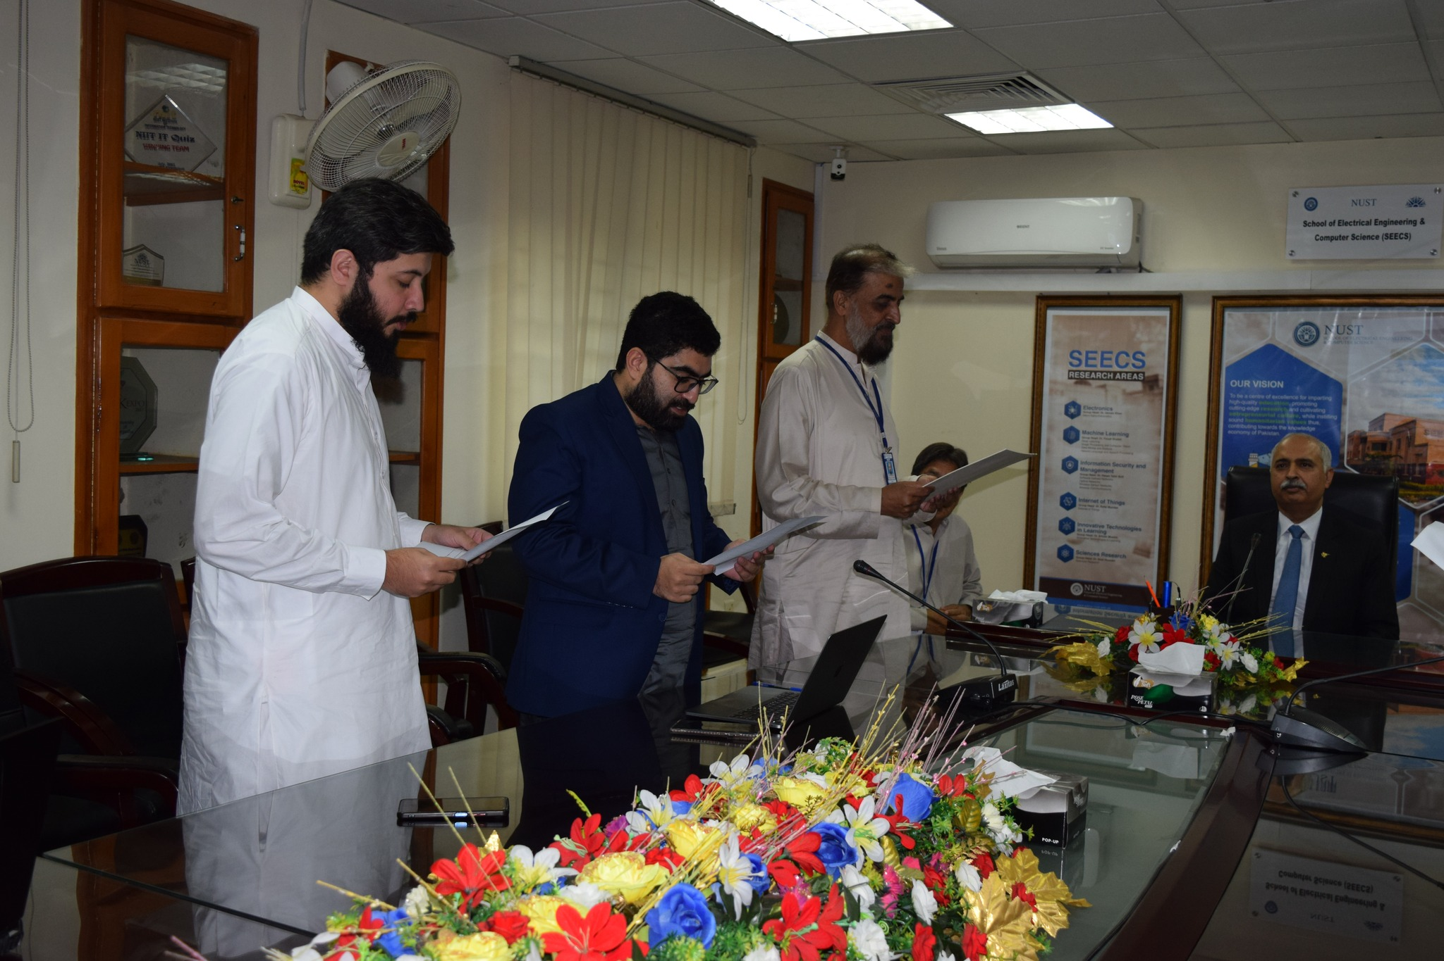
SEECS Alumni Association – VP Endowment

Slide 12
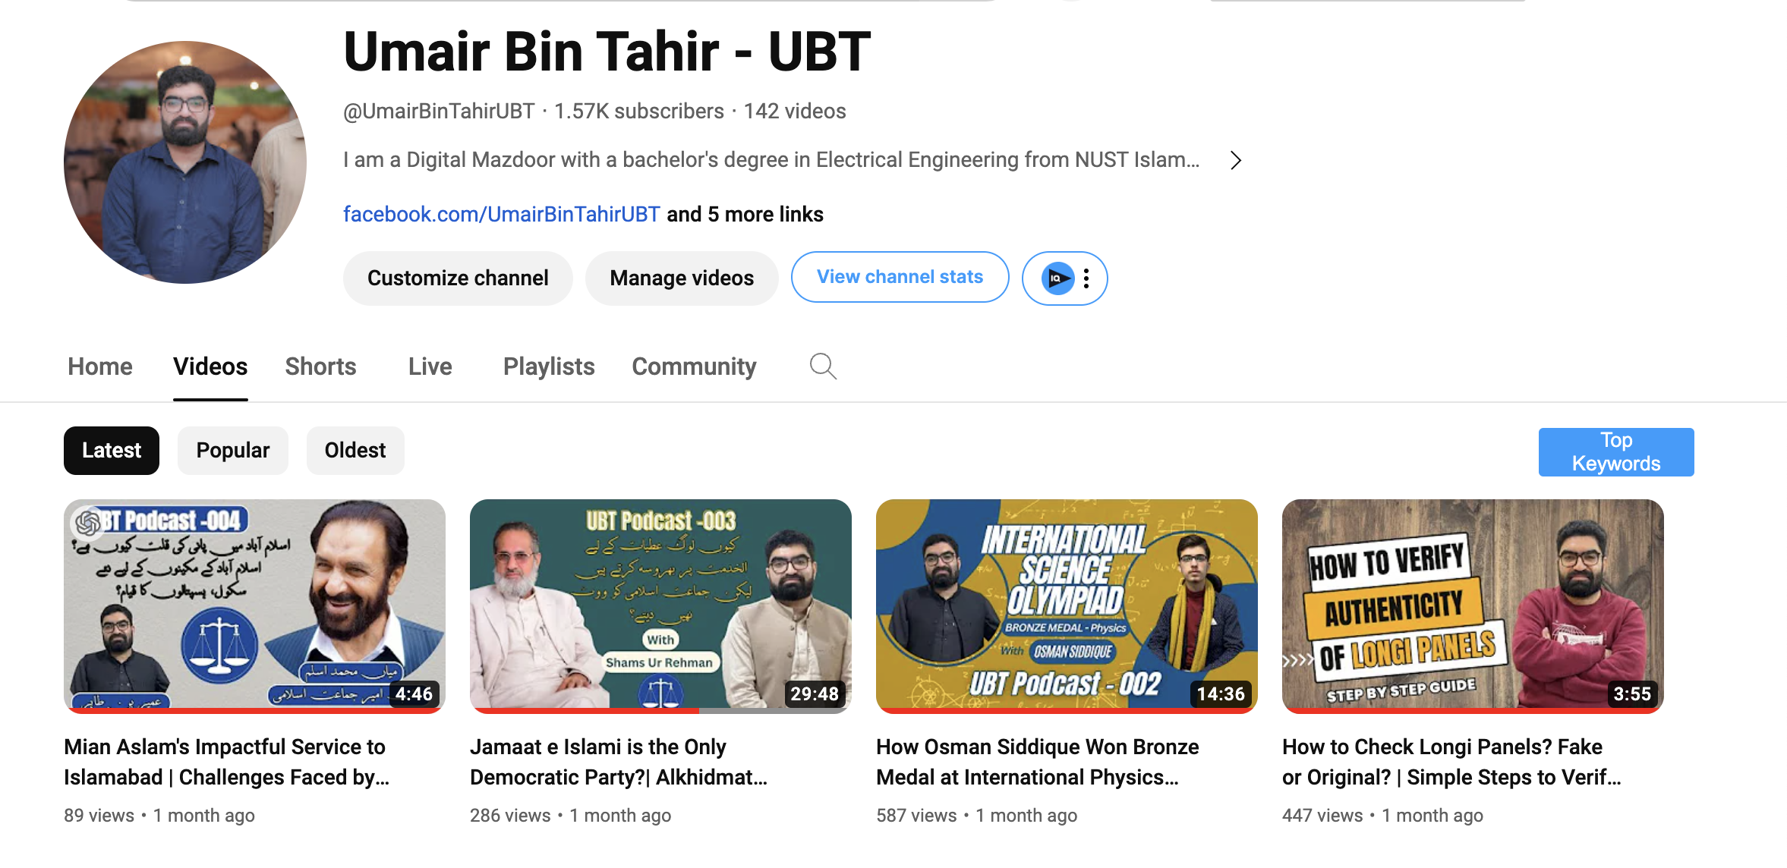
Youtube Channel – Content Creation

Slide 13
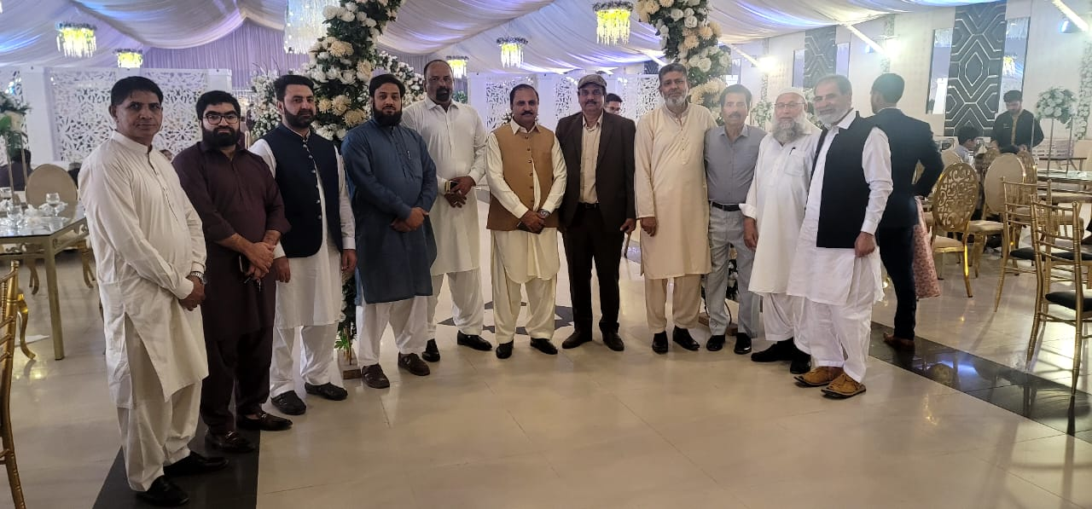
Resident Welfare Association - MPCHS

Slide 14
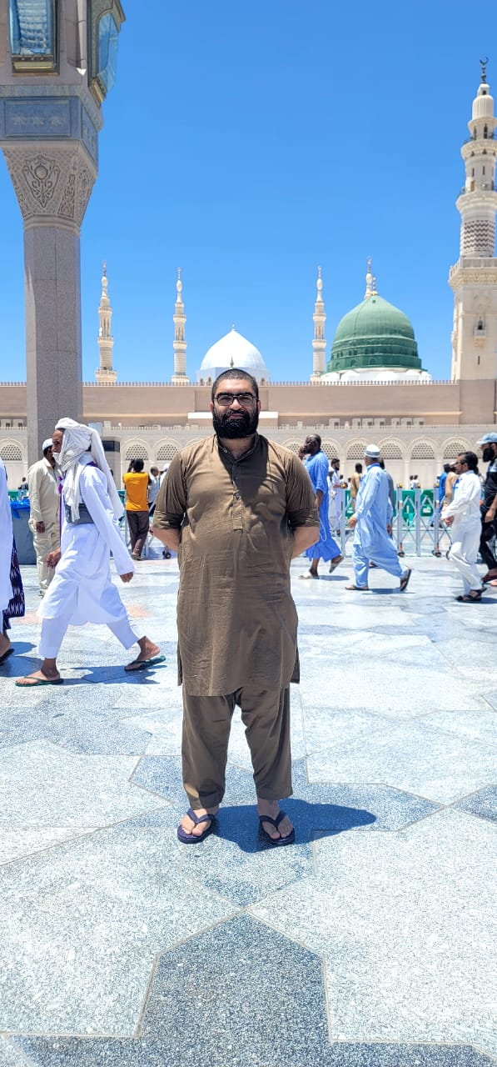
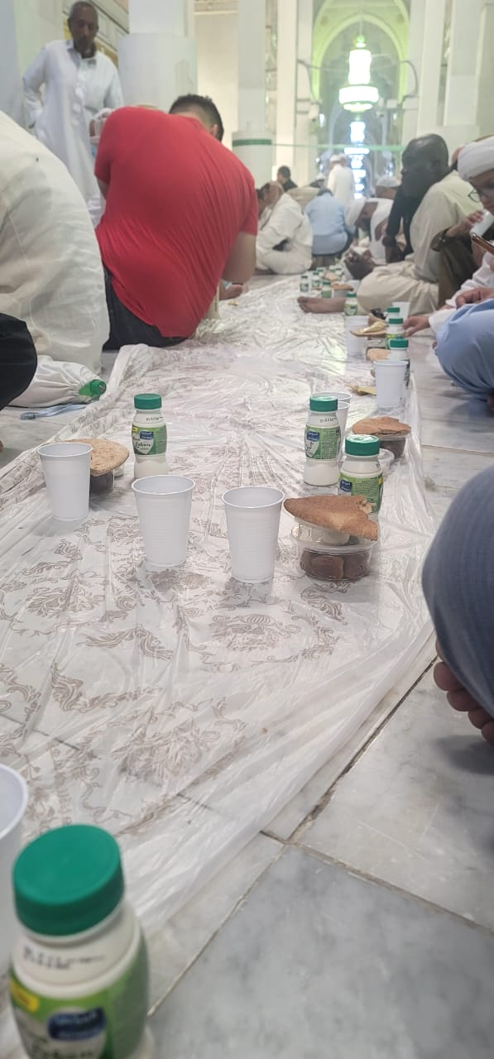
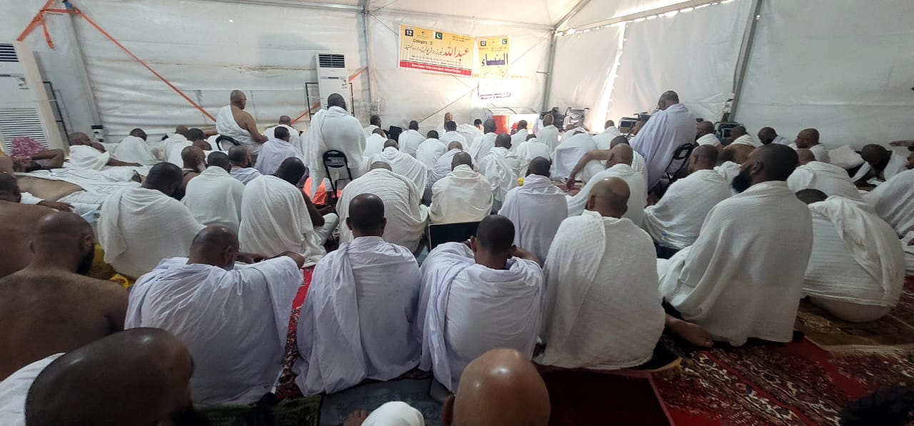
Hajj & Umrah
Hajj 2023
Hajj 2022
Umrah 2022

Slide 15
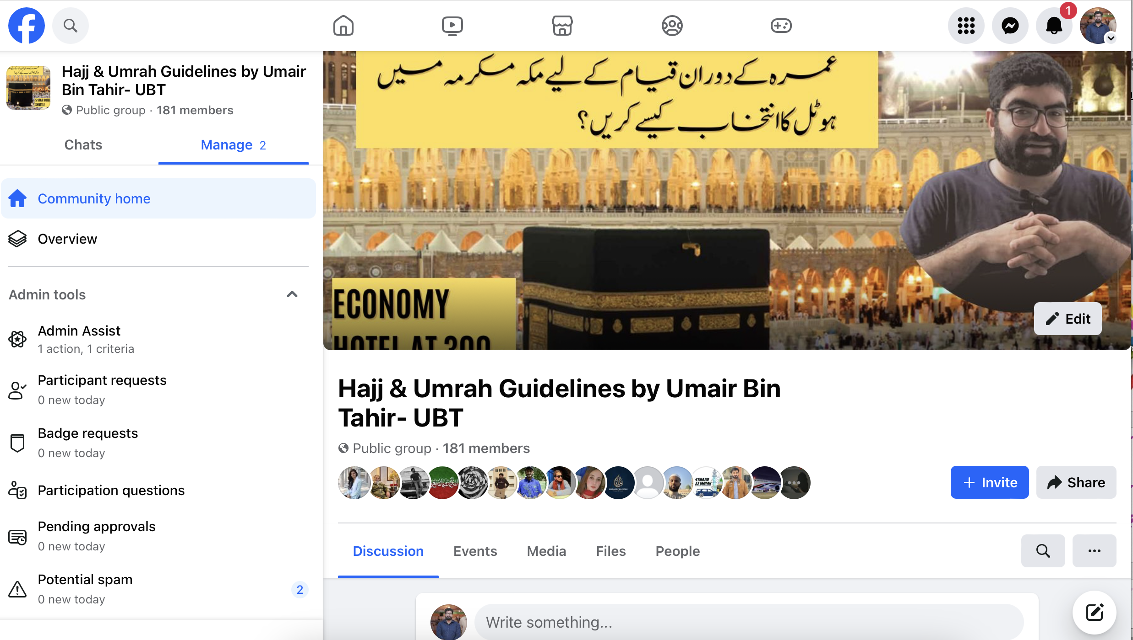
Hajj & Umrah Support Group

Slide 16
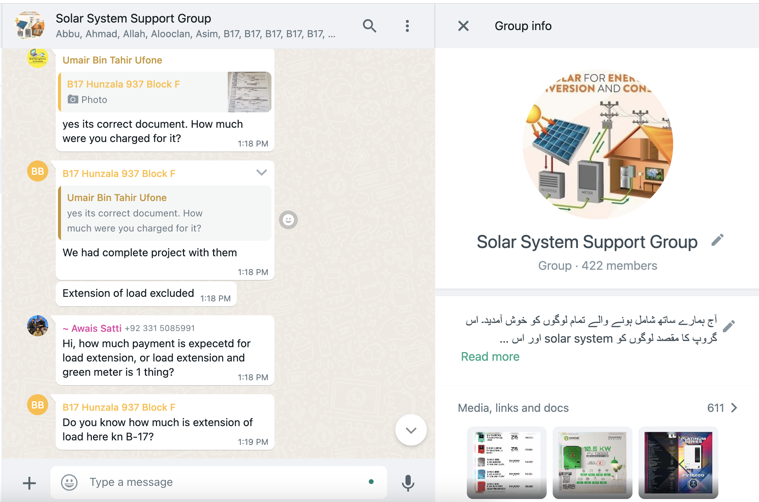
Solar System Support Group

Slide 17
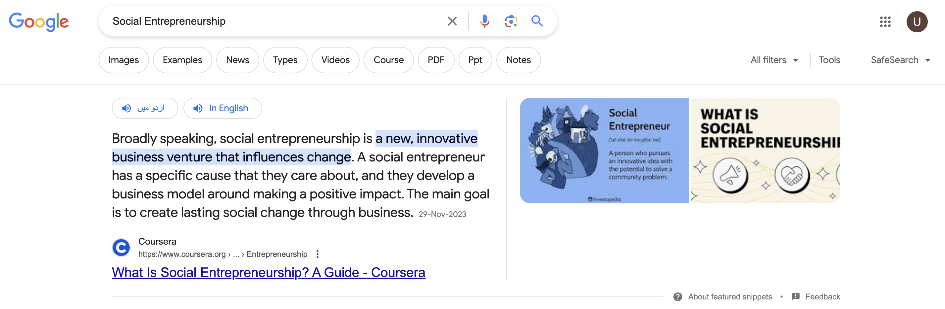
Social Entrepreneurship

Slide 18
Social Entrepreneurs in Pakistan
Dr. Amjad Saqib (Akhuwat Foundation)
Huzaifa Ahmad (Rizq)
Muneeb Maayr (Bykea)
Kalsoom Lakhani (i2i)
Saad Hamid (DEMO)
Javed Afridi (Peshawer Zalmi)
Ehsan Imam (Marham)
Sehat Kahani (Dr. Sara Saeed Khurram)
Hira Batool Rizvi (Shekab)
Dr. Musstanser Tinauli (Fori Mazdoori)

Slide 19
Social Entrepreneurs from SEECS & NUST
Hamza Afridi (Cykiq)
Savings 9 (Abdullah Bin Abbas)
Shamyl Bin Mansoor (Learn o bots)
Chadar (Wajiha & Kamil Hamad)

Slide 20
How to Start?
Observe.
Identify your passion.
Find your why?
Identify a problem you are passionate about.
Meet relevant people
Find mentor

Slide 21
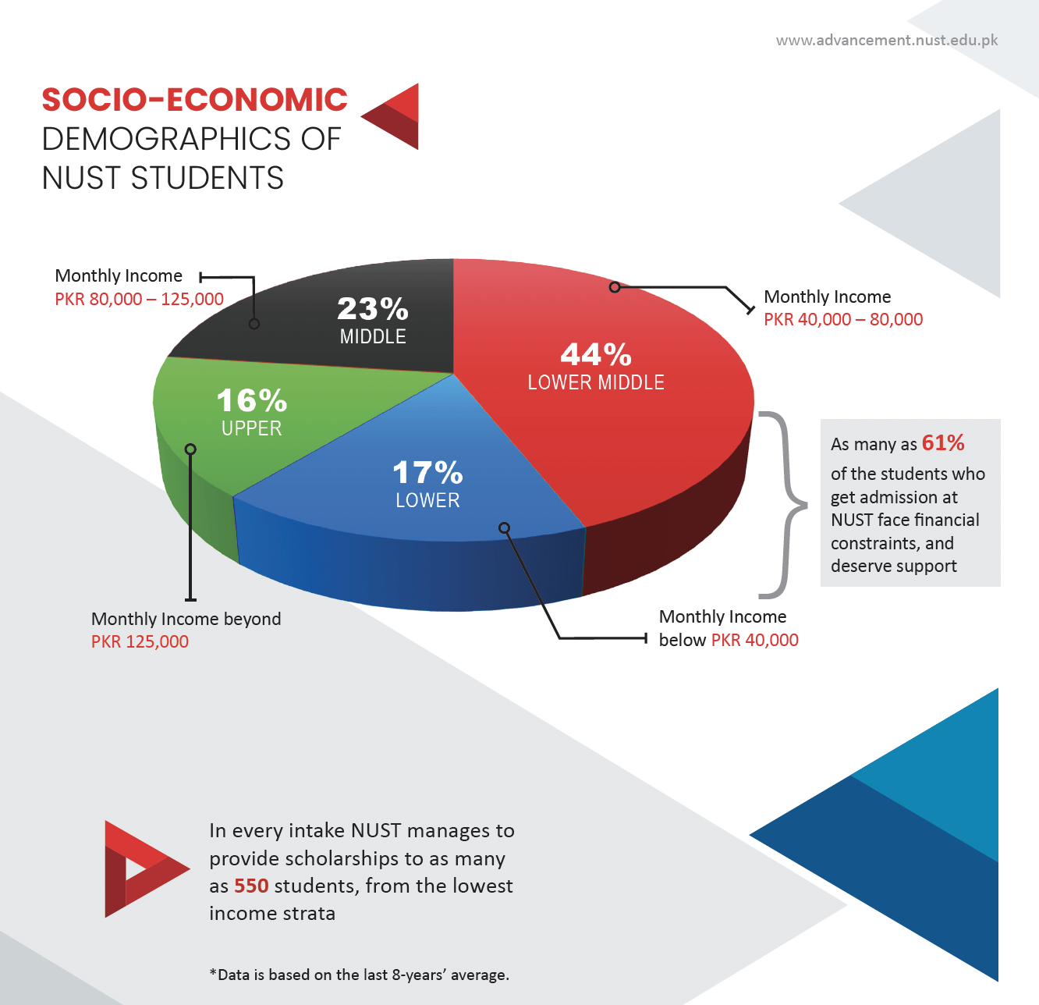
What Motivates Me?

Slide 22
Why We Owe to NUST/Pakistan and it’s People?
Tuition Fee for 6 months: PKR 150,000
Expense per day: (PKR 150,000) / (6 months * 30) = PKR 833.33
Ministry of Education, HEC & PEC
Tax Money of poor people. (GST on buying everything)

Slide 23
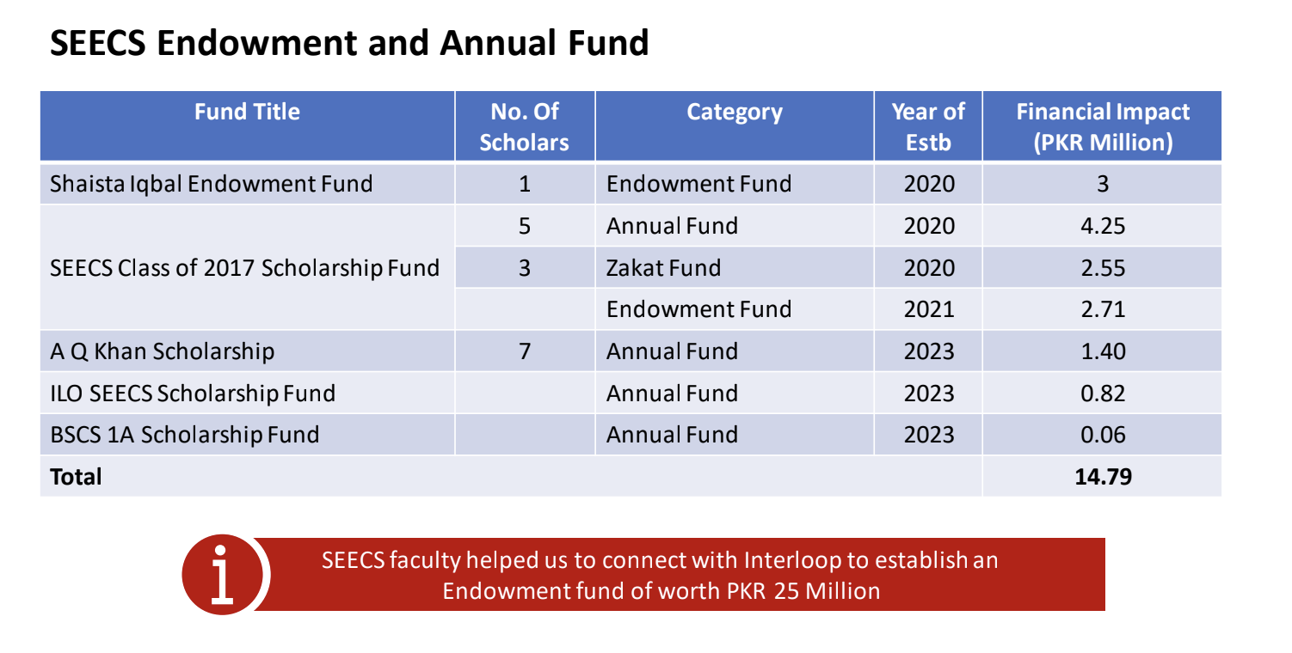
Spirit of Giving Back

Slide 24
Point to Ponder
5000 Alumni of SEECS as per Alumni Portal
Official figures say we have 8000 alumni
Total contribution from SEECS: PKR 14.79 Million = PKR 1.5 Crore only
Only a few alumni
Majority Scholarship Awardees are from SEECS
Did you contribute back to your school/college?

Slide 25
Final Thoughts!
While we donate, our donations could have a greater impact if we were more strategic and focused on long-term solutions.
We contribute to charitable causes, but often lack responsibility and sustainability in our donations.
Rich People Weddings

Slide 26


How SEECS Alumni Association Can Help & Vice Versa?

